Slide 1


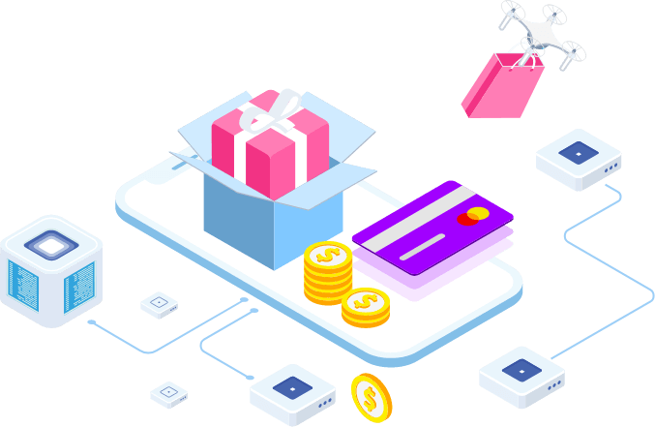
ShopForHome – An Ecommerce Webapp
GreatLearning
Capstone Project Presentation
Group - 9
Supervised By:
Parth Shukla
Presented By:
Utkarsh Srivastava
Nasreen Sulthana Shaik

Slide 2
Agenda
Business Requirements
Roadmap of the Project
Why Angular & Spring boot ?
Tools and Technologies
Angular Structure
Spring Boot Structure
MySQL Database
Features provided
App Deployment on Google Cloud Platform
Web-Application Demo

Slide 3
Business Requirements
GCP-IP-APR/CPP/25.08.2022
To build a web based Ecommerce application using Angular & Spring Boot.
Categorised with two different individuals : User and Admin.
User having dashboard to buy a product, Add a product to Cart and Wishlist as per their modifications.
Admin having dashboard to CRUD on User and Products.
Admin having several other features like Bulk Products Upload, Creating discounts, getting sales report, able to mail for Products shortages.
Deployment of the application on Google cloud platform.

Slide 4
RoadMap of the Project
GCP-IP-APR/CPP/25.08.2022
Frontend
Creating UI using Angular
Running on Local Host
Backend
Microservices using Spring Boot
Running on Local host
Database
Creating a schema
Linking it to Backend
Deployment
Hosting on Web
Building Container images

Slide 5
Why Angular & Spring Boot ?
GCP-IP-APR/CPP/25.08.2022
Cross Platform
Easy to learn, Use and Test
SPA-Oriented
Two–way Data Binding
Angular CLI
Spring Application
Admin Features
YAML Support
Security
Properties Files

Slide 6
Tools and Technologies
GCP-IP-APR/CPP/25.08.2022
Tools Used
Technologies Used
Visual Studio Code
Eclipse IDE
MySQL Workbench 8.0 CE
Postman
Google Cloud Platform
GitHub
Angular Framework
Bootstrap v5
Spring boot framework
Node JS
Java JDK 11
Git

Slide 7


Angular Structure
GCP-IP-APR/CPP/25.08.2022
Module Component {}
Module Services {}
Meta Data
Templates
< >
Module Value 3.1415
Module fn
Directive
{ }
Injector
Property
Binding
Event
Binding
Service
{ }
Component
{ }

Slide 8

Spring Boot Structure
GCP-IP-APR/CPP/25.08.2022
Repository Class Extending CRUD Services
Dependency Injection
HTTP
request
Client
(Angular)
Controller
Service Layer
Model
Database
JPA/ Spring Data
Client Port : 4200
Spring Boot Port : 8080

Slide 9

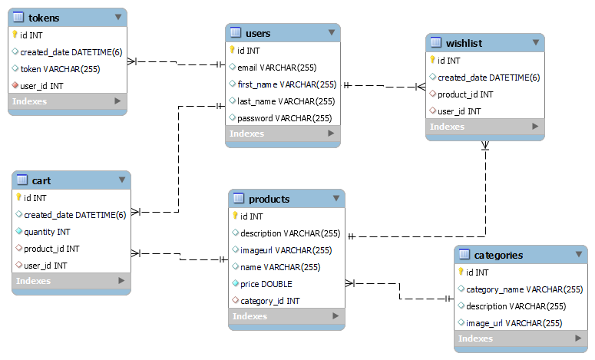
MySQL Database
GCP-IP-APR/CPP/25.08.2022
ShopForHome Schema/ Database
Tables
Backend
(Spring boot)

Slide 10
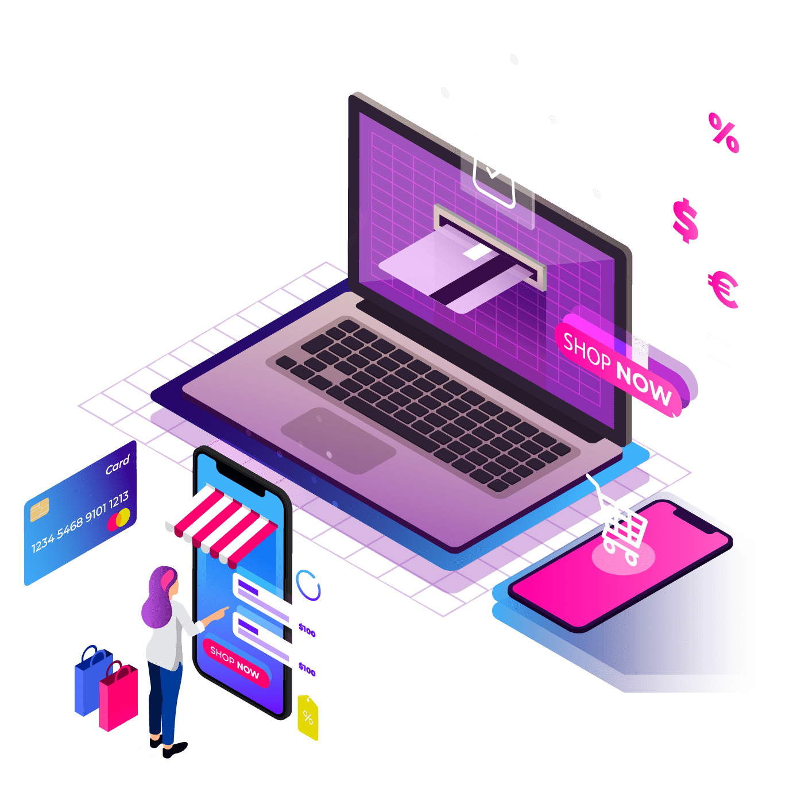







Features Provided
GCP-IP-APR/CPP/25.08.2022
User & Admin registration, Login and logout.
Shopping Cart and Wishlist.
Search Bar filters and Products sorting Options.
Bulk Products upload.
Sales and Reports options.
Email on lesser stocks.
Mobile Compatibility.

Slide 11

App Deployment on GCP
GCP-IP-APR/CPP/25.08.2022
Creating the Docker file for the Angular.
Creating the Docker file along with the JAR executable file for Spring boot.
Accessing the GCP console and authorizing Cloud Shell.
Creating a directory.
Cloning the project git repository.
Building the docker images for angular and Spring boot application.
Running the docker container for frontend and backend on different ports.

Slide 12
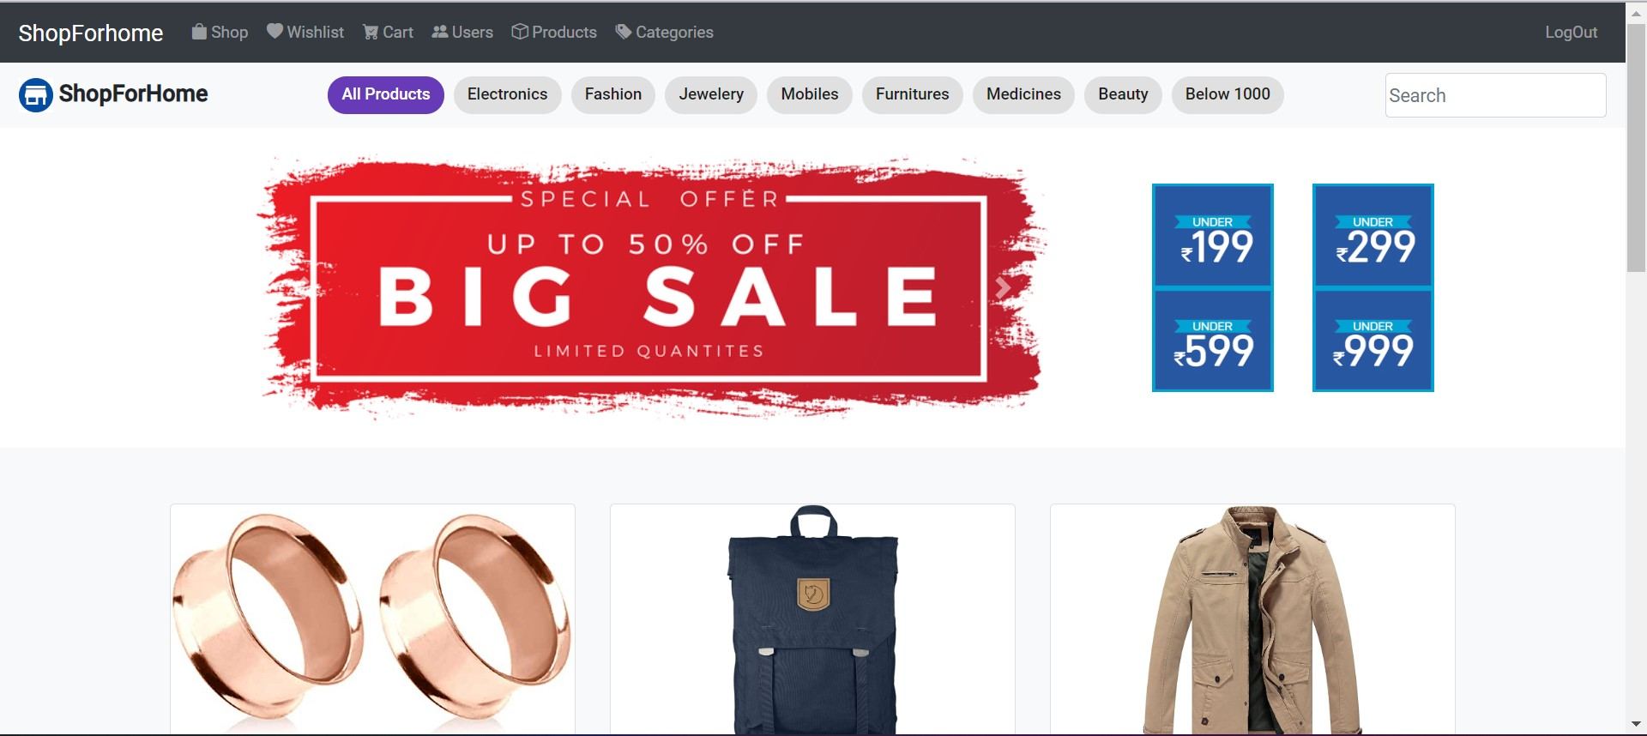
Web Application Demo
GCP-IP-APR/CPP/25.08.2022

Slide 13
Thank You

